Slide 1

Postgraduate Diploma of Specialization Applied Economics and Data Analysis Department of Economics School of Economics and Business Administration University Of Patras
E-commerce: trends and effects on the Greek economy
Panagiotis Panou
Supervisor: Giannakopoulos Nikolaos
12/09/2023

Slide 2
Introduction
Scientific field: microeconomic and more specifically the consumer's theory.
Research question: the evolution of e-commerce, internet use, and e-banking in Greece as and individuals’ profile who implement these uses.
Additional objectives: individuals’ profile for online activities, types of goods e-purchased and online seller’s origin choice.
Topic importance and interest groups: businesses, entrepreneurs and start-ups, financial institutions, researchers and academics, governmental and regulatory agencies.

Slide 3
Literature Review
Relevant researches
Internet use, e-commerce, e-banking:
De Blasio (2008) used data from the Survey of Household Income and Wealth (SHIW) by the Bank of Italy and shows that individuals with higher family income, education and younger in age are strongly positively correlated with internet use, e-commerce, e-banking. The city size of residence, and the presence of children are less significant with positive correlation between these variables.

Slide 4
Literature Review
E-commerce:
Song & Sun (2020)used data from the Chinese Household Financial Survey finds that those with higher incomes, younger people, married couples, people with higher levels of education, and people who live in cities are more likely to shop online.
Ganning & Green (2021): men are more inclined than women to shop online ( data from the US Census Bureau databases).
E-banking:
Bauer & Hein (2006) who examines the demand for remote access to banking accounts by consumers, having data from the Survey of Consumer Finances (SCF), and Hitt & Frei (2002), reaching the same conclusions regarding the profile of individuals concerning the e-banking.

Slide 5
Literature Review
E-commerce and Covid-19
Chang & Meyerhoefer (2021): used data which concerns Taiwan and finds that an additional confirmed case of COVID-19 increased sales by 5.7% and the number of customers by 4.9%.
Alcedo et al., (2022): They discover that internet sales increased across the board in most economies during the COVID-19 pandemic using data from 47 economies and 26 industries.
Watanabe, T., & Omori, Y. (2020):used data from credit card transactions conclude that because of COVID-19, some customers who had never made purchases online decided to do so and that the main group responsible for the increase in online consumption are consumers who were already familiar with it before the pandemic.

Slide 6
Data
Data source: Hellenic Statistical Authority's (ELSTAT) Survey on the Use of Information and Communication Technologies by Households and Individuals (ICT).
Type of data: independent cross-sectional
Sample period: 2009-2022, in annual frequency
Number of total observations: 66,667
Variables used: Internet use, e-commerce, e-banking, age, gender , education level, employment status, income, household size, children in household, residence area, phone or videocall, electronic seller, frequency of internet use, household goods, medicines, apparel and footwear, tech devices, year, online seller’s origin.

Slide 7
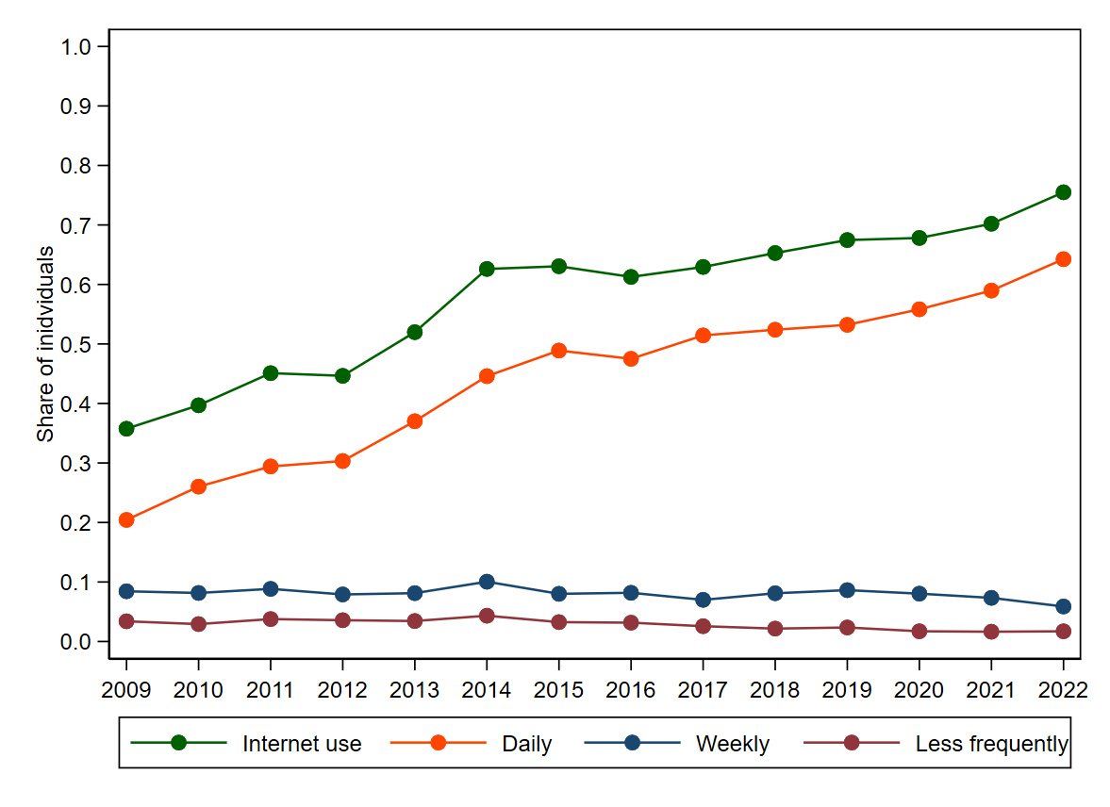
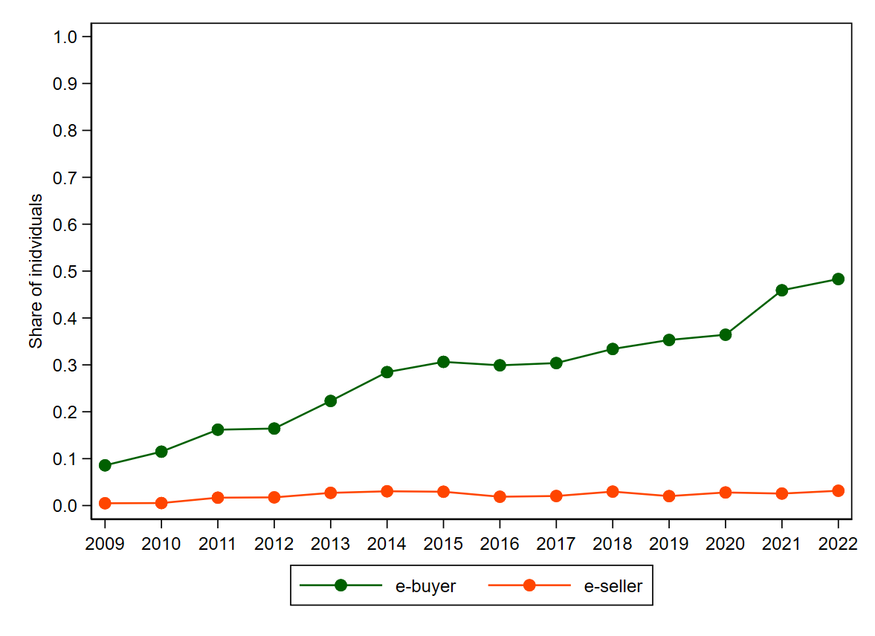
Data
Figure 1. The percentage change of Internet use and its frequency over time
Figure 2. The percentage change of individual’s status on e-commerce over time

Slide 8
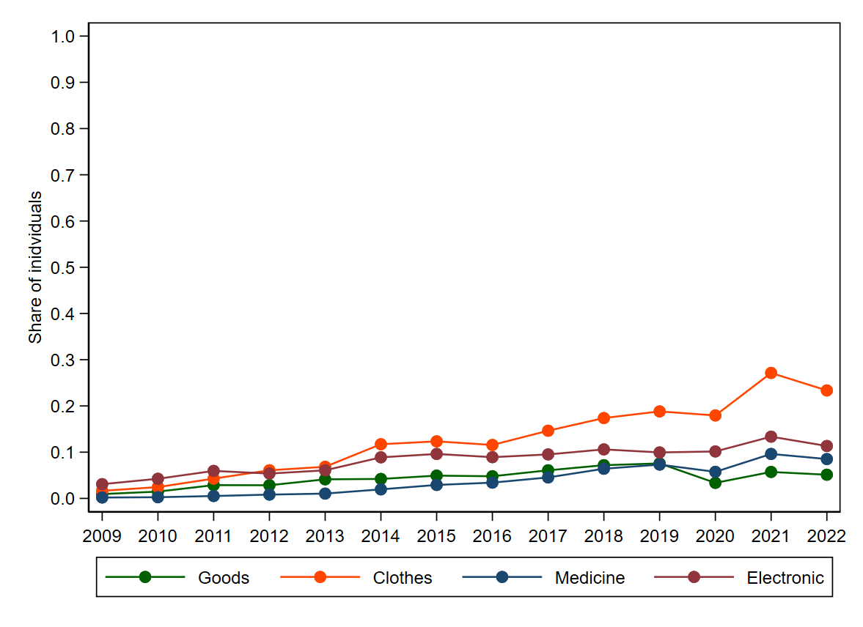
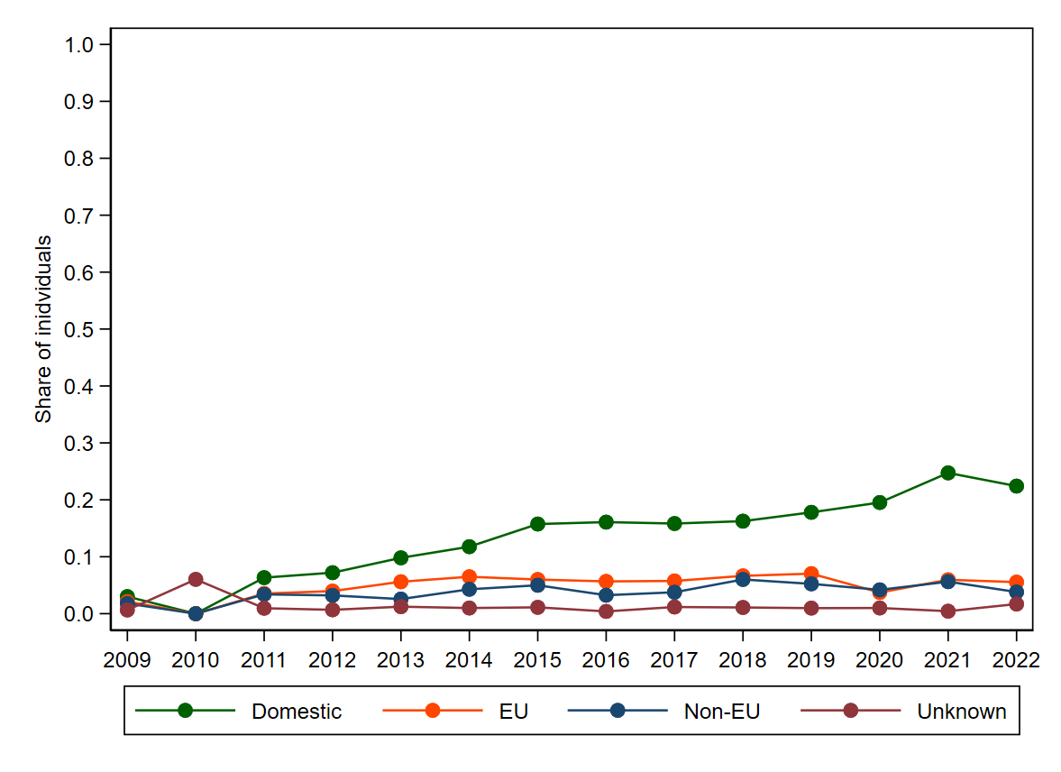
Data
Figure 3. The percentage change of types of goods e-purchased over time
Figure 4. The percentage change of electronic buys by seller’s origin over time

Slide 9
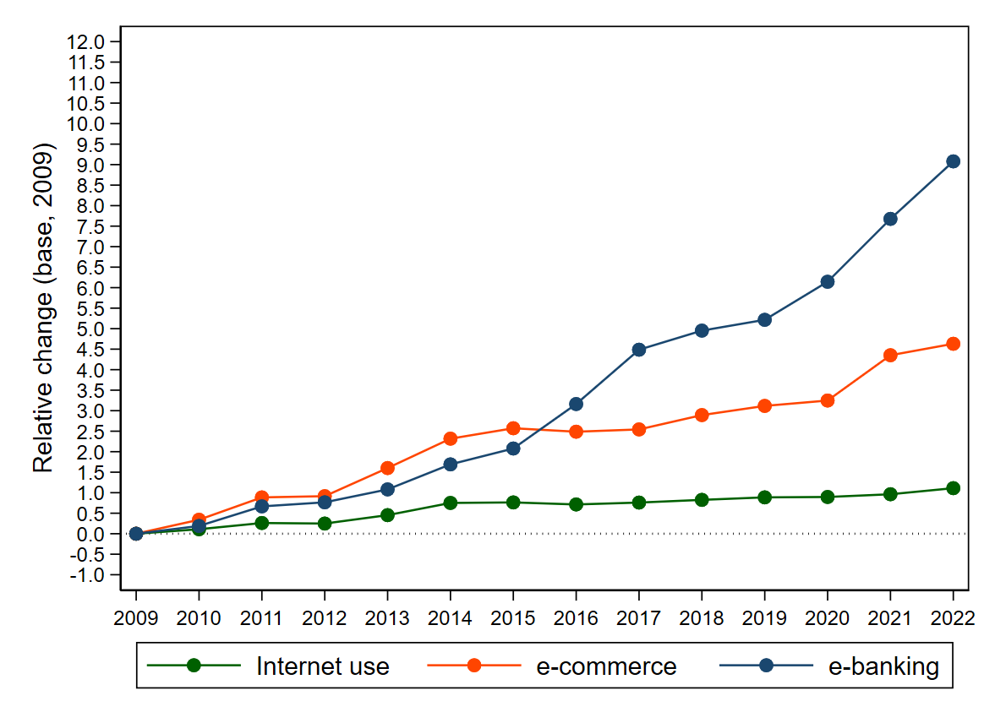
Data
Figure 5. The evolution of Internet use, e-commerce and e-banking over time

Slide 10
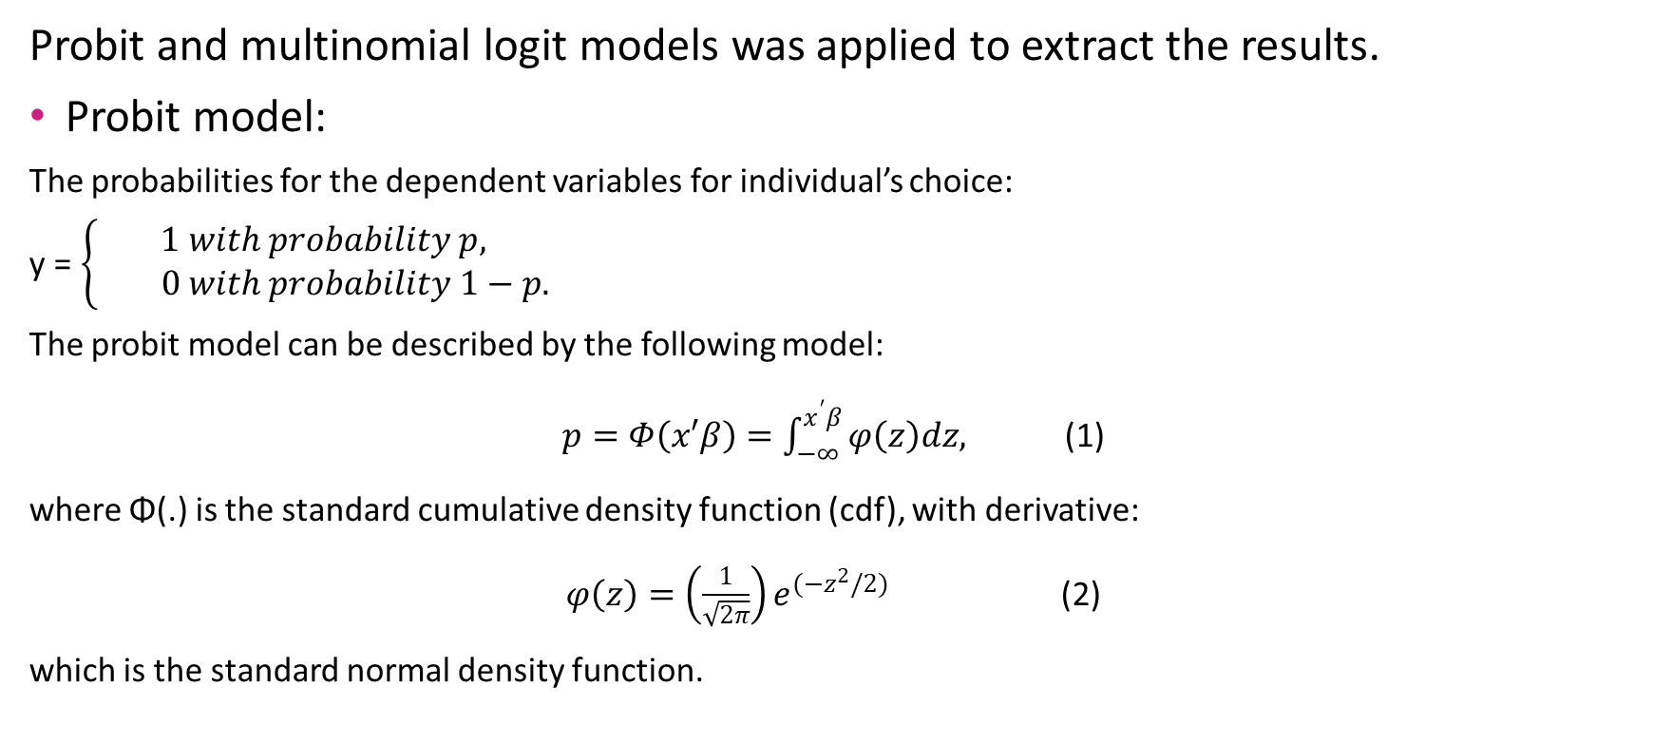
Methodology
Probit and multinomial logit models was applied to extract the results.
Probit model:
The probabilities for the dependent variables for individual’s choice:
y =$\left\{\begin{aligned}1 with probability p, \\ 0 with probability 1−p.\end{aligned}\right.$
The probit model can be described by the following model:
$p=Φ\left(x′β\right)=\int_{−∞}^{x^{′}β}{φ\left(z\right)dz,}$ (1)
where Φ(.) is the standard cumulative density function (cdf), with derivative:
$φ\left(z\right)=\left(\frac{1}{\sqrt{2π}}\right)e^{{(−z}^{2}/2)}$ (2)
which is the standard normal density function.

Slide 11
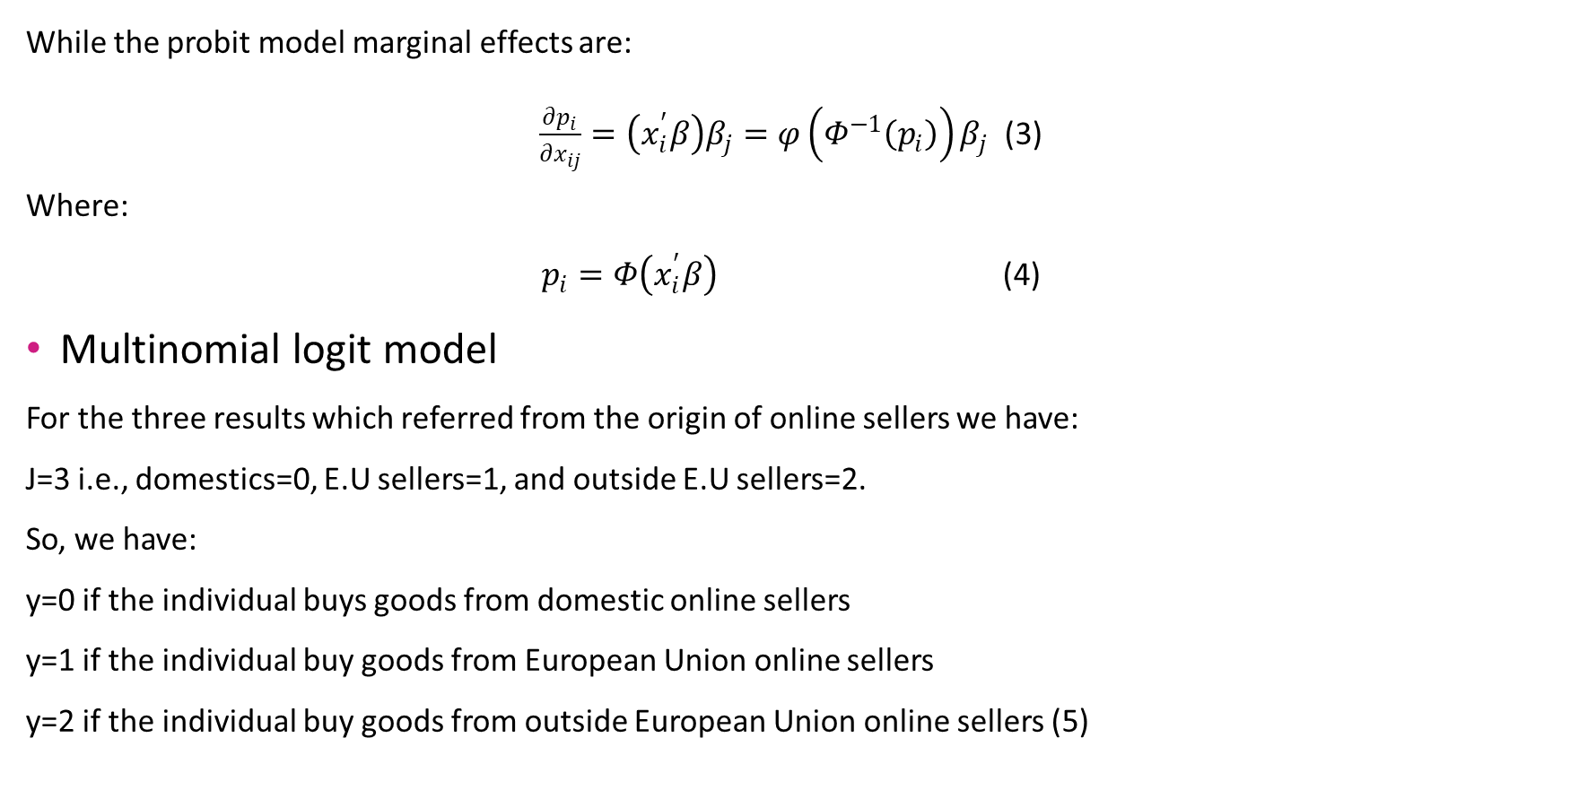
Methodology
While the probit model marginal effects are:
$\frac{∂p_{i}}{∂x_{ij}}=\left(x_{i}^{′}β\right)β_{j}=φ\left(Φ^{−1}\left(p_{i}\right)\right)β_{j}$ (3)
Where:
$p_{i}=Φ\left(x_{i}^{′}β\right)$ (4)
Multinomial logit model
For the three results which referred from the origin of online sellers we have:
J=3 i.e., domestics=0, E.U sellers=1, and outside E.U sellers=2.
So, we have:
y=0 if the individual buys goods from domestic online sellers
y=1 if the individual buy goods from European Union online sellers
y=2 if the individual buy goods from outside European Union online sellers (5)

Slide 12
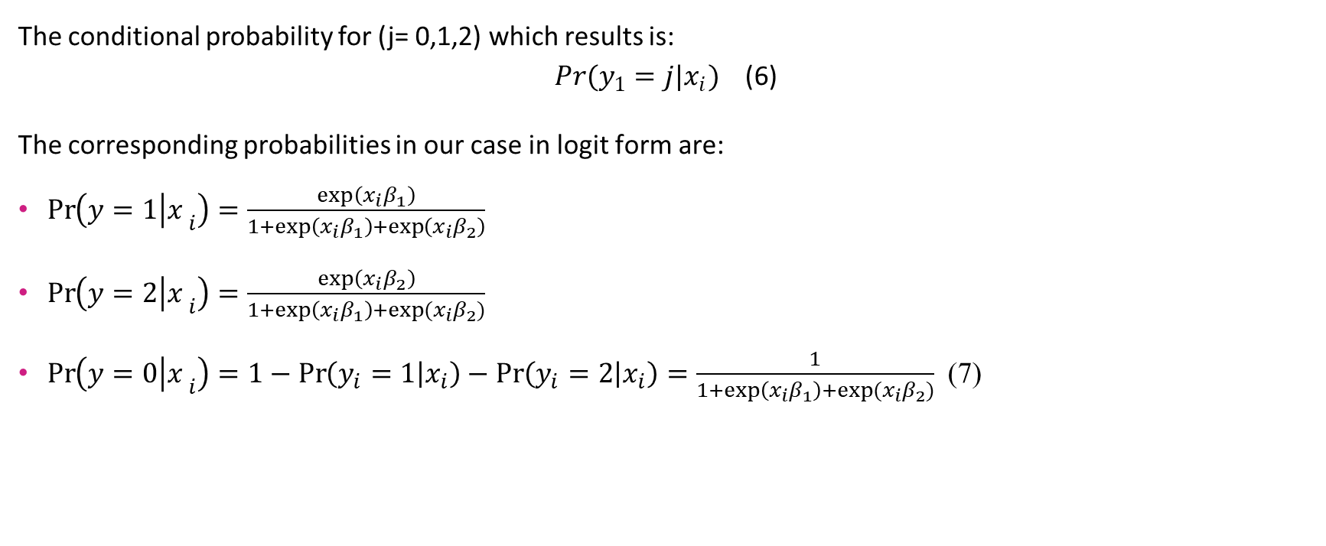
Methodology
The conditional probability for (j= 0,1,2) which results is:
$Pr(y_{1}=j|x_{i})$ (6)
The corresponding probabilities in our case in logit form are:
$\operatorname{Pr}\left(y=1 | {x_{ }}_{i}\right)=\frac{\exp\left(x_{i}β_{1}\right)}{1+\exp\left(x_{i}β_{1}\right)+\exp\left(x_{i}β_{2}\right)}$
$\operatorname{Pr}\left(y=2 | {x_{ }}_{i}\right)=\frac{\exp\left(x_{i}β_{2}\right)}{1+\exp\left(x_{i}β_{1}\right)+exp⁡(x_{i}β_{2})}$
$\operatorname{Pr}\left(y=0 | {x_{ }}_{i}\right)=1−\operatorname{Pr}\left(y_{i}=1 | x_{i}\right)−\operatorname{Pr}\left(y_{i}=2 | x_{i}\right)=\frac{1}{1+\exp\left(x_{i}β_{1}\right)+exp⁡(x_{i}β_{2})}$ (7)

Slide 13

Methodology
While for the marginal effects we have:
$\frac{∂\operatorname{Pr}\left(y=1 | {x_{ }}_{i}\right)}{∂x_{ik}}=\operatorname{Pr}\left(y=1 | {x_{ }}_{i}\right) \left[β_{1k}−\frac{β_{1k}\exp\left(x_{i}β_{1}\right)+β_{2k}\exp\left(x_{i}β_{2}\right)}{1+\exp\left(x_{i}β_{1}\right)+exp⁡(x_{i}β_{2})}\right]$
$\frac{∂\operatorname{Pr}\left(y=2 | {x_{ }}_{i}\right)}{∂x_{ik}}=\operatorname{Pr}\left(y=2 | {x_{ }}_{i}\right) \left[β_{2k}−\frac{β_{1k}\exp\left(x_{i}β_{1}\right)+β_{2k}\exp\left(x_{i}β_{2}\right)}{1+\exp\left(x_{i}β_{1}\right)+exp⁡(x_{i}β_{2})}\right]$
$\frac{∂\operatorname{Pr}\left(y=0 | {x_{ }}_{i}\right)}{∂x_{ik}}=\operatorname{Pr}\left(y=0 | {x_{ }}_{i}\right) \left[−\frac{β_{1k}\exp\left(x_{i}β_{1}\right)+β_{2k}\exp\left(x_{i}β_{2}\right)}{1+\exp\left(x_{i}β_{1}\right)+exp⁡(x_{i}β_{2})}\right]$ (8)

Slide 14
Results
Table 1. Determinants of Internet use, e-commerce and e-banking (marginal effects, probit).
A)Determinants for Internet use, e-commerce and e-banking
Variable | Internet use | e-commerce | e-banking
 | [1] | [2] | [3]
Age 25-34 | -.135*** (.006) | -.103*** (.009) | -.002 (.007)
Age 35-44 | -.214*** (.006) | -.175*** (.008) | -.018*** (.007)
Age 45-54 | -.318*** (.006) | -.258*** (.008) | -.051*** (.006)
Age 55-64 | -.446*** (.006) | -.361*** (.008) | -.099*** (.006)
Age 65-74 | -.598*** (.006) | -.446*** (.008) | -.158*** (.006)
Female | -.021*** (.002) | -.034*** (.003) | -.046***(.002)
Medium education | .207***(004) | .137***(003) | .105***(003)
Higher education | .365***(005) | .290***(004) | .228***(004)
Unemployed | -.023***(005) | -.045***(004) | -.066***(004)
Student | -.001(008) | -.047***(006) | -.066***(006)
Inactive | -.074***(004) | -.054***(004) | -.064***(004)
Household income | .138***(004) | .125***(004) | .103***(004)
Household size | -.011***(001) | -.015***(001) | -.015***(001)
Children in household | .044***(004) | .036***(004) | .028***(003)
Region: Central Greece | .001**(003) | .021***(004) | .030***(003)
Region: Attica | .045***(003) | .032***(004) | .057***(003)
Region: Islands and Crete | .021***(005) | .045***(005) | .027***(004)
Pseudo R-squared | .495 | .351 | .344
Observations | 66,667
Results confirmed from: Mills and Whitacre (2003), De Blasio (2008) for internet us, De Blasio (2008) Ganning and Green (2021), Zhou and Wang's (2014), Song & Sun (2020) for the e-commerce and De Blasio (2008), Bauer and Hein (2006), and Hitt and Frei (2002) for the e-banking.
Source: Survey on the Use of Information and Communication Technologies by Households and Individuals (ICT, 2009-2022), Hellenic Statistical Authority (EL.STAT.), Public Use Microdata Files.
Notes: Reference category for “Age” is the group “16-24”, for “Gender” is the sex “Male”, for “Education level” is the level “Low”, for the “Employment status” is the status “Employed”, and for the “Residence area” is the region “Northern Greece”. All models include year dummies.
Robust standard errors in parentheses. * p < .10, ** p < .05, *** p < .01

Slide 15
Results
Table 2. Determinants of phone or videocall and electronic seller (marginal effects, probit) from individuals who use the internet.
B)Determinants of individual’s online activities
Variable | phone or videocall | electronic seller
 | [1] | [2]
Age 25-34 | -.096***(009) | -.005(006)
Age 35-44 | -.170***(009) | -.009*(005)
Age 45-54 | -.217***(009) | -.021***(005)
Age 55-64 | -.274***(010) | -.028***(005)
Age 65-74 | -.331***(012) | -.036***(005)
Female | .013***(005) | -.025***(002)
Medium education | .046***(007) | .012***(002)
Higher education | .125***(007) | .026***(003)
Unemployed | -.021***(008) | -001(003)
Student | .028**(011) | -.006(004)
Inactive | -.009(007) | -.009***(003)
Household income | .048***(007) | .016***(003)
Household size | -.018***(002) | -.005***(001)
Children in household | -.001(006) | .005**(003)
Region: Central Greece | .001(006) | .001(002)
Region: Attica | .029***(006) | .011***(003)
Region: Islands and Crete | .024***(009) | -.001(003)
Pseudo R-squared | .146 | .054
Observations | 36,986
Source: Survey on the Use of Information and Communication Technologies by Households and Individuals (ICT, 2009-2022), Hellenic Statistical Authority (EL.STAT.), Public Use Microdata Files.
Notes: Reference category for “Age” is the group “16-24”, for “Gender” is the sex “Male”, for “Education level” is the level “Low”, for the “Employment status” is the status “Employed”, and for the “Residence area” is the region “Northern Greece”. All models include year dummies.
Robust standard errors in parentheses. * p < .10, ** p < .05, *** p < .01

Slide 16
Results
Table 3. Determinants of types of goods e-purchased (marginal effects, probit) from individuals who makes e-commerce.
C) Determinants of types of goods e-purchased
Variable | household goods | medicines | apparel and footwear | tech devices
 | [1] | [2] | [3] | [4]
Age 25-34 | .084***(.011) | .038***(.011) | .012(.016) | .015(.014)
Age 35-44 | .105***(.012) | .068***(.012) | -.048***(.016) | .021(.015)
Age 45-54 | .104***(.012) | .050***(.011) | -.091***(.016) | .008(.015)
Age 55-64 | .112***(.013) | .064***(.013) | -.143***(.018) | -.007(.016)
Age 65-74 | .112***(.019) | .060***(.017) | -.237***(.023) | -.046**(.020)
Female | -.006 (.006) | .073***(.006) | .103***(.008) | -.140***(.007)
Medium education | .014(.011) | .025**(.010) | .001(.014) | .002(.012)
Higher education | .028**(.012) | .044***(.010) | -.027*(.014) | .035***(.012)
Unemployed | -.001(.010) | .016*(.010) | -.042***(.013) | -.011(.011)
Student | .024(.016) | -.013(.014) | -.040**(.018) | .062***(.017)
Inactive | .013(.010) | .006(.010) | -.016(.012) | .001(.011)
Household income | .039***(.009) | .031***(.008) | .044***(.011) | .042***(.010)
Household size | -.014***(.003) | -.005(.003) | .010***(.004) | -.002(.003)
Children in household | .026***(.009) | .024***(.008) | .007(.010) | -.009(.009)
Region: Central Greece | -.011(.009) | .037***(.008) | -.029***(.011) | .004(.010)
Region: Attica | -.002(.008) | .048***(.007) | -.059***(.010) | -.046***(.009)
Region: Islands and Crete | .012(.012) | .015(.010) | -.023*(.014) | -.027**(.013)
Pseudo R squared | .028 | .086 | .082 | .043
Observations |  | 15,868
Results confirmed from: De Blasio (2008)
Source: Survey on the Use of Information and Communication Technologies by Households and Individuals (ICT, 2009-2022), Hellenic Statistical Authority (EL.STAT.), Public Use Microdata Files.
Notes: Reference category for “Age” is the group “16-24”, for “Gender” is the sex “Male”, for “Education level” is the level “Low”, for the “Employment status” is the status “Employed”, and for the “Residence area” is the region “Northern Greece”. All models include year dummies.
Robust standard errors in parentheses. * p < .10, ** p < .05, *** p < .01

Slide 17
Results
Table 6: Determinants of online seller’s origin choice (marginal effects, multinomial logit), individuals who makes e-commerce and have bought goods or services from one of the three origin seller’s categories.
D) Determinants of online seller’s origin choice
Variable | Domestics | E.U sellers | Outside E.U sellers
Age 25-34 | .049***(.017) | -.035**(.016) | -.014(.015)
Age 35-44 | .081***(.017) | -.028*(.016) | -.053***(.015)
Age 45-54 | .097***(.018) | -.054***(.016) | -.042***(.015)
Age 55-64 | .143***(.018) | -.065***(.017) | -.077***(.015)
Age 65-74 | .183***(.023) | -.093***(.020) | -.089***(.018)
Female | .083***(.008) | -.015**(.007) | -.068***(.006)
Medium education | -.060***(.014) | .031***(.012) | .028***(.011)
Higher education | -.146***(.015) | .086***(.012) | .060***(.011)
Unemployed | .002(.013) | -.008(.011) | .006(.011)
Student | -.023(.018) | .013(.016) | .010(.014)
Inactive | -.002(.013) | -.005(.011) | .007(.011)
Household income | -.093***(.012) | .039***(.011) | .054***(.010)
Household size | .021***(004) | -.007**(003) | -.014***(003)
Children in household | .002(.011) | -.017*(.010) | .015*(.009)
Region: Central Greece | -.036***(.011) | .002(.010) | .034***(.008)
Region: Attica | -.090***(.010) | .022*(.009) | .068***(.008)
Region: Islands and Crete | .022(.014) | -.031(.012) | .009(.011)
Pseudo R-squared |  | 0.042
Observations |  | 14,738
Results confirmed from Mu and Zhang (2021)
Source: Survey on the Use of Information and Communication Technologies by Households and Individuals (ICT, 2009-2022), Hellenic Statistical Authority (EL.STAT.), Public Use Microdata Files.
Notes: Reference category for “Age” is the group “16-24”, for “Gender” is the sex “Male”, for “Education level” is the level “Low”, for the “Employment status” is the status “Employed”, and for the “Residence area” is the region “Northern Greece”. All models include year dummies.
Robust standard errors in parentheses. * p < .10, ** p < .05, *** p < .01

Slide 18
Conclusions
Research purpose: the determination of demographic characteristics (i.e., age and the individual's sex), human capital characteristics (i.e., individual’s education), the household financial status (i.e., monthly household income), the household structure (i.e., household size and presence of children), the personal financial situation (i.e., the individuals employment status) and the individuals residence area affects their choice for the totally referred online activities and the evolution of e-commerce, internet use, and e-banking in Greece.
Methods applied: Probit and multinomial logit
Main papers we relied on: De Blasio, G. (2008), Song & Sun (2020)

Slide 19
Conclusions
Totally key findings from probit regression models
Vital individual’s determinants
Ages groups: the older the age group to which the individual belongs, the less likely to make any of the online activities mentioned.
Education level: the higher the individual’s education level is, the more likely to make any online activities.
Income: a crucial factor which the higher it is increases individual’s likelihoods totally for any online activity.
Less important individual’s determinants
Employment status: employed seem to be more likely to carry out any online activity.
Household size: the more members the household has, the more likely it is that its members do not carry out any online activity.
Presence of children: increases the possibilities of any online activity by household members.

Slide 20
Conclusions
Key findings from multinomial logit regression model
Vital individual’s determinants
Ages groups: the older the individual the more likely to choose a domestic online seller.
Education level: the higher the individual’s education level is, the less likely to prefer a domestic online seller.
Income: the higher the household’s income the more likely he is not to prefer online domestics sellers.
Less important individual’s determinants
Gender: women seem more likely to prefer domestics online sellers.
Household size: the more members the household has, the more likely it is that its members will choose online domestics sellers.

Slide 21
Conclusions
Key findings from figures
Covid 19 and capital controls are two shocks in the Greek economy which when they occurred caused a launch in the use of e commerce and e banking percentages, respectively.
Finally, in terms of the evolution and trends of the three main variables of interest, is observed that electronic banking has a rapid evolution in time, quite large is noted for electronic commerce and finally steady and slowly in creasing trends for the internet usage.

Slide 22
Conclusions
Contribution, Limitations &Suggestions
Nevertheless, our results can be the trigger and the basis for further study on the subject not only of electronic commerce with applied data for Greece but mainly for deepening in the online activities of the individuals where there is no literature on the specific online activities we studied for our country, but also and the consumer's preferences for online products and the place of origin of online sellers where the literature is limited.

Slide 23
References
Alcedo, J., Cavallo, A., Dwyer, B., Mishra, P., & Spilimbergo, A. (2022). E-Commerce During COVID: Stylized Facts from 47 Economies. (NBER Working Paper Series No. 29729). Available at: http://www.nber.org/papers/w29729
Bauer, K., & Hein, S. E. (2006). The effect of heterogeneous risk on the early adoption of Internet banking technologies. Journal of Banking & Finance, 30, 1713–1725. Available at: https://www.sciencedirect.com/science/article/pii/S0378426605001810
Chang, H. H., & Meyerhoefer, C. D. (2021). COVID-19 and the Demand for Online Food Shopping Services: Empirical Evidence from Taiwan. American Journal of Agricultural Economics, 103(2), 448–465. Available at: https://onlinelibrary.wiley.com/doi/full/10.1111/ajae.12170
De Blasio, G. (2008). Urban–Rural Differences in Internet Usage, e-Commerce, and e-Banking: Evidence from Italy. Growth and Change, 39(2), 341–367. Available at: https://onlinelibrary.wiley.com/doi/abs/10.1111/j.1468-2257.2008.00422.x
Ganning, J. P., & Green, T. (2021). "The online marketplace: Zero-order city or new source of social inequality?" Growth and Change. Advance online publication. Available at: https://onlinelibrary.wiley.com/doi/epdf/10.1111/grow.12514
Hitt, L. M., & Frei, F. X. (2002). Do better customers utilize electronic distribution channels? Thecase of PC banking. Management Science, 48(6), 732–748. Available at: https://pubsonline.informs.org/doi/abs/10.1287/mnsc.48.6.732.188
Mills, B. F., & Whitacre, B. E. (2003). Understanding the Non-Metropolitan–Metropolitan Digital Divide. Growth and Change, 34(2), 219-243. Available at: https://onlinelibrary.wiley.com/doi/abs/10.1111/1468-2257.00215
Mu, J., & Zhang, J. Z. (2021). Seller marketing capability, brand reputation, and consumer journeys on e-commerce platforms. Journal of the Academy of Marketing Science, 49, 994-1020. Available at: https://link.springer.com/article/10.1007/s11747-021-00773-3
Song, S., & Sun, Q. (2020). "Online Consumption and Income Efficiency: Evidence from China." The Chinese Economy, 53(6), 465-476. Available at: https://www.tandfonline.com/doi/full/10.1080/10971475.2020.1792068
Watanabe, T., & Omori, Y. (2020). Online Consumption During and After the COVID-19 Pandemic: Evidence from Japan. Available at: http://www.crepe.e.u-tokyo.ac.jp/results/2020/CREPEDP91.pdf
Zhou, Y., & Wang, X. (2014). Explore the relationship between online shopping and shopping trips: An analysis with the 2009 NHTS data. Transportation Research Part A, 70, 1-9. Available at: https://www.sciencedirect.com/science/article/pii/S096585641400233X

Slide 24
Thank you all for your attention!

